Slide 1

APEX INSTITUTE OF TECHNOLOGY
DEPARTMENT OF COMPUTER SCIENCE & ENGINEERING
Artificial Intelligence (22CST-347)
Faculty: Dr. Priyanka Kaushik
DISCOVER . LEARN . EMPOWER

Slide 2
Artificial Intelligence : Course Objectives
COURSE OBJECTIVES
(AI) is a research field that studies how to realize the intelligent human behaviors on a computer. The ultimate goal of AI is to make a computer that can learn, plan, and solve problems autonomously. Although AI has been studied for more than half a century, we still cannot make a computer that is as intelligent as a human in all aspects, The main research topics in AI include: problem solving, reasoning, planning, natural language understanding, computer vision, automatic programming, machine learning, and so on. Of course, these topics are closely related with each other. In this course, we will study the most fundamental knowledge for understanding AI. We will introduce some basic search algorithms for problem solving; knowledge representation and reasoning; pattern recognition; fuzzy logic; and neural networks

Slide 3
COURSE OUTCOMES
On completion of this course, the students shall be able to:-
CO4 | Co4 Design and evaluate intelligent expert models for perception and prediction from intelligent environment.
CO5 | CO5 Understanding and Implementation of Expert Systems and different Gaming playing approaches for different types of AI applications

Slide 4
Unit-3 Syllabus
Unit-3 |  | Contact Hours:15 hours
Ch1.Expert systems | Expert systems: - Introduction, structure of expert systems, Expert System Life Cycle, problem areas addressed by expert systems, Application of Expert, Knowledg Acquisition Types of expert systems.
Ch2.Game playing | Game playing Min-Max Search, Alpha-Beta Pruning,MonkeyBanana Problem,Water Jug Problem
Ch3. Application in Modern AI | Modern AI application, decision making , predictive analysis and adaptive analytics

Slide 5
SUGGESTIVE READINGS
TEXT BOOKS
T1. Artificial Intelligence: A Modern Approach by Stuart Russell and Peter Norvig. Prentice-Hall, 2003 (2ndEdition). T2. Elaine Riche, Kevin Knight and Shivashankar B. Nair, “Artificial Intelligence”, Third Edition, TMH Educations Pvt. Ltd., 2008
REFERENCE BOOKS
R1 Nils J. Nilsson, “The Quest for Artificial Intelligence”, Second Edition, Cambridge University Press, 2009
R2 Artificial Intelligence and Expert Systems – Dan W. Patterson, Prentice Hall of India

Slide 6
Introduction
A system that integrates knowledge from experts is called a knowledge-based decision support system (KBDSS) or intelligent decision support system (IDSS).
Some decisions need judgmental knowledge that resides in human experts.
The KBDSS can enhance decisions by supplying tools and enhance computerized DSS.
The foundation of building such systems is the techniques and tools that have been developed in the area of artificial intelligence (AI).

Slide 7
12.1 Opening Vignette
Knowledge in association is often lost due to employee turnover.
Rules of business is coded in complex if-then statements makes its change and development a slow and expensive process.
The need for rule-based intelligent system that can automate certain decision-making events is necessary.
Rule-based system is a system that allows experts to describe their knowledge in plain English, then converts that description into business rules, which can be incorporated into a rule base for further inference

Slide 8
(12.2) Concepts and Definitions of Artificial Intelligence in terms of expert system
In some decision situations, the support of data and models may not be sufficient. Additional support is needed, such as that provided by rule-base expert systems (ES) to substitute for human expertise by supplying knowledge.
Knowledge-based systems (KBS)
Technologies that use qualitative knowledge rather than mathematical models to provide the needed supports
The major technology underlying these applications is artificial intelligence

Slide 9
(12.2) Concepts and Definitions of Artificial Intelligence
Artificial intelligence (AI) definitions
Artificial intelligence (AI)
The subfield of computer science concerned with studying thoughts processes of humans and representing those processes via machines.
How to make computers do things that, at the moment, people are better
AI’s goal is to mimic human intelligence
Turing test
A test designed to measure the “intelligence” of a computer

Slide 10
(12.2) Concepts and Definitions of Artificial Intelligence
Characteristics of artificial intelligence
Symbolic processing (AI deals primarily with symbolic, nonalgorithmic methods of problem solving)
Numeric versus symbolic: symbolic processing is the core of AI
Algorithmic versus heuristic: human processes tend to be nonalgorithmic (relies on rules learned from experience)
Heuristics
intuitive knowledge learned from experience.
By using heuristics, we do not have to rethink completely what to do every time we encounter a similar problem.
AI methods use heuristics to reduce the complexity of problem solving

Slide 11
(12.2) Concepts and Definitions of Artificial Intelligence
Characteristics of artificial intelligence
Inferencing
Reasoning capabilities that can build higher-level knowledge from existing heuristics
This reasoning consists of inferencing from facts and rules, using heuristics approaches.
Machine learning
Learning capabilities that allow systems to adjust their behavior and react to changes in the outside environment (similar to human)

Slide 12
(12.3) The Artificial Intelligence Field in expert sysyem
Evolution of artificial intelligence
Naïve solutions stage (primitive solutions to problems to outperform human )
General methods stage (developing more effective problem solving methods)
Domain knowledge stage (develop real-world applications)
Expert system or a knowledge-based system
Multiple integration stage (need to integrate multiple techniques and solve problems in multiple domains)
Embedded applications stage (embed various intelligent components in popular applications)

Slide 13
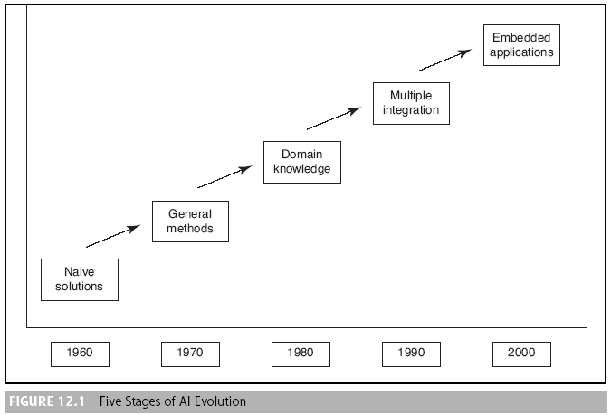
(12.3) The Artificial Intelligence Field

Slide 14
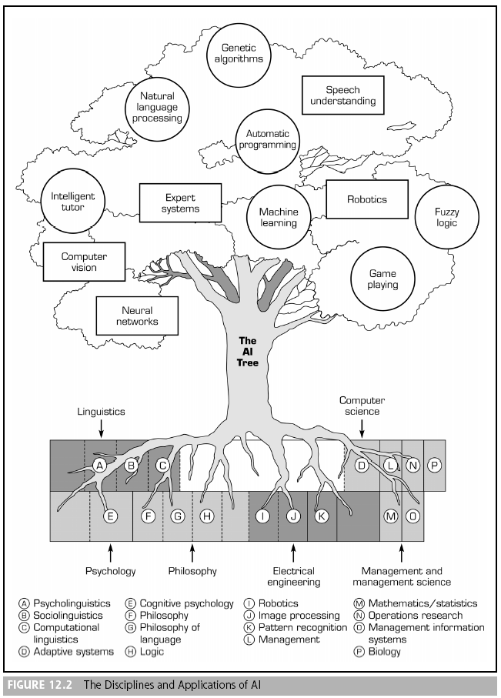

Slide 15
(12.3) The Artificial Intelligence Field
Applications of artificial intelligence
AI is a collection of concepts and ideas that are related to the development of an intelligent system
Expert system (ES)
A computer system that applies reasoning methodologies to knowledge in a specific domain to render advice or recommendations, much like a human expert.
A computer system that achieves a high level of performance in task areas that, for human beings, require years of special education and training

Slide 16
(12.3) The Artificial Intelligence Field
Applications of artificial intelligence
Natural language processing (NLP)
Using a natural language processor to interface (conversational type interface) with a computer-based system
Two subfields of NLP
Natural language understanding (computers understand human)
Natural language generation (computers talks like human)
Speech (voice) understanding
Translation of the human voice into individual words and sentences understandable by a computer

Slide 17
(12.3) The Artificial Intelligence Field
Applications of artificial intelligence
Robotics and sensory systems
Sensory system
such as vision systems, tactical systems and signal processing systems.
Robots
Machines that have the capability of performing manual functions without human intervention
An “intelligent” robot has some kind of sensory apparatus, such as a camera, that collects information about the robot’s operation and its environment so as to interpret and respond to the change rather than just follow instructions

Slide 18
(12.3) The Artificial Intelligence Field
Computer vision and scene recognition
Visual recognition
The addition of some form of computer intelligence and decision-making to digitized visual information, received from a machine sensor such as a camera
The basic objective of computer vision is to interpret scenarios rather than generate pictures

Slide 19
(12.3) The Artificial Intelligence Field
Intelligent computer-aided instruction (ICAI)
The use of AI techniques for training or teaching with a computer
Intelligent tutoring system (ITS)
Self-tutoring systems that can guide learners in how best to proceed with the learning process (bear on the educational process)

Slide 20
(12.3) The Artificial Intelligence Field
Automatic programming
Allows computer programs to be automatically generated when AI techniques are embedded in compilers

Slide 21
(12.3) The Artificial Intelligence Field
Neural computing
Neural (computing) networks
An experimental computer design aimed at building intelligent computers that operate in a manner modeled on the functioning of the human brain. See artificial neural networks (CANN)

Slide 22
(12.3) The Artificial Intelligence Field
Game playing
One of the first areas that AI researchers studied
It is a perfect area for investigating new strategies and heuristics because the results are easy to measure

Slide 23
(12.3) The Artificial Intelligence Field
Language translation
Automated translation uses computer programs to translate words and sentences from one language to another without much interpretation by humans

Slide 24
(12.3) The Artificial Intelligence Field
Fuzzy logic
is a technique for processing linguistics terms.
Logically consistent ways of reasoning that can cope with uncertain or partial information; characteristic of human thinking and many expert systems
Genetic algorithms
Intelligent methods that use computers to simulate the process of natural evolution to find patterns from a set of data

Slide 25
(12.3) The Artificial Intelligence Field
Intelligent agent (IA)
An expert or knowledge-based system embedded in computer-based information systems (or their components) to make them smarter

Slide 26
(12.4) Basic Concepts of Expert Systems (ES)
ES are computer-based information systems that use expert knowledge to attain high level decision performance in a narrow problem domain.
The basic concepts of ES include:
How to determine who experts are
How expertise can be transferred from a person to a computer
How the system works

Slide 27
(12.4) Basic Concepts of Expert Systems (ES)
Expert
A person who has the special knowledge, judgment, experience, and methods to give advice and solve problems, along with the ability to apply these talents.
Decision performance and the level of knowledge a person has are typically criterion used to determine whether a person is an expert.

Slide 28
(12.4) Basic Concepts of Expert Systems (ES)
Expertise
The extensive, task-specific knowledge that experts possess.
The level of expertise determines the performance of a decision.
Training, reading and experience in practice achieve expertise.

Slide 29
(12.4) Basic Concepts of Expert Systems (ES)
Features of ES
Expertise: An EX must possess expertise that enables it to make expert-level decision
Symbolic reasoning: knowledge must be represented symbolically
Deep knowledge: concerns the level of expertise in a knowledge base.
Self-knowledge: must have a strong learning capabilities to update their knowledge constantly (from success, failure, and other knowledge resources).

Slide 30
(12.4) Basic Concepts of Expert Systems (ES)
Why we need ES
Since experts may retire or leave, ES are an excellent tool for preserving professional knowledge crucial to a company's competitiveness
ES is an excellent tool for documenting professional knowledge for examination or improvement
ES is a good tool for training new employees and disseminating knowledge in an organization
ES allow knowledge to be transferred more easily at a lower cost
See table 12.1 for comparisons of conventional and experts systems.
See table 12.2 for differences between human experts and expert systems

Slide 31
(12.5) Applications of ES
Classical successful ES
DENDRAL: for molecular structure identification
MYCIN: for medical diagnosis
XCON: for configuration of the VAX computer
Rule-based system
A system in which knowledge is represented completely in terms of rules (e.g., a system based on production rules)

Slide 32
(12.5) Applications of ES
Newer applications of ES
Credit analysis systems : used in banks for risk management assessment
Pension(راتب تقاعد) fund advisors : help employees to plan their retirement through their analysis that calculates their pension benefits under different scenarios
Automated help desks: enables small business to deal with customer requests more efficiently
Homeland security systems:
Market surveillance مراقبةsystems
Business process reengineering systems

Slide 33
(12.5) Applications of ES
Areas for ES applications
Finance
Data processing
Marketing
Human resources
Manufacturing
Homeland security
Business process automation
Health care management

Slide 34
(12.6) Structure of ES
ES environments:
Development environments
Parts of expert systems that are used by builders to build the components and put knowledge into the knowledge base.
It includes the knowledge base, the inference engine, knowledge acquisition, and improving reasoning capability.
The knowledge engineer and the expert are considered part of these environments

Slide 35
(12.6) Structure of ES
Consultation environment
The part of an expert system that is used by a non-expert to obtain expert knowledge and advice.
It includes the workplace (backboard), inference engine, explanation facility, recommended action, and user interface

Slide 36
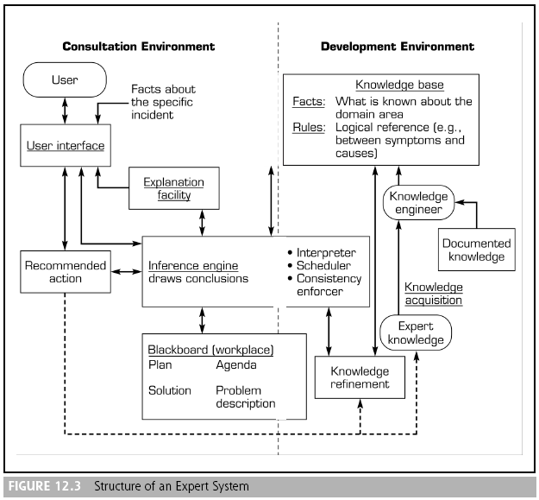
(12.6) Structure of ES

Slide 37
(12.6) Structure of ES
Three major components in ES are:
Knowledge base
Inference engine
User interface
ES may also contain:
Knowledge acquisition subsystem
Blackboard (workplace)
Explanation subsystem (justifier)
Knowledge refining system

Slide 38
(12.6) Structure of ES
Knowledge acquisition (KA)
The extraction and formulation of knowledge derived from various sources, especially from human experts
other sources: multimedia documents, textbooks, DB, research reports, and the Web.
Knowledge base
A collection of facts, rules, and procedures organized into schemas. The assembly of all the relevant information and knowledge about a specific field of interest
Q) What is the difference between the knowledge base of an ES and the knowledge base of an organization?

Slide 39
(12.6) Structure of ES
Inference engine
The part of an expert system (program) that provides a methodology for reasoning about information in the KB and on the blackboard for formulating conclusions.
User interfaces
The parts of computer systems that interact with users, accepting commands from the computer keyboard and displaying the results generated by other parts of the systems

Slide 40
(12.6) Structure of ES
Blackboard (workplace)
An area of working memory set aside for the description of a current problem and for recording intermediate results in an expert system
Explanation subsystem (justifier)
The component of an expert system that can explain the system’s reasoning and justify its conclusions

Slide 41
(12.6) Structure of ES
Knowledge-refining system
A system that has the ability to analyze its own performance, learn, and improve itself for future consultations

Slide 42
(12.7) How ES Work: Inference Mechanisms
Knowledge representation and organization
Expert knowledge must be represented in a computer-understandable format and organized properly in the knowledge base
Different ways of representing human knowledge include:
Production rules: easy to understand and adding new rules is easy
Semantic networks:
Logic statements
See example (rules 1, 2, and 3) page 556

Slide 43
(12.7) How ES Work: Inference Mechanisms
The inference process
Inference is the process of chaining multiple rules together based on available data to cover numerous conditions, since expert knowledge can not be represented in single rule.

Slide 44
(12.7) How ES Work: Inference Mechanisms
Popular approaches for inferencing:
Forward chaining
A data-driven search in a rule-based system
Backward chaining
A search technique (employing IF-THEN rules) used in production systems that begins with the action clause of a rule and works backward through a chain of rules in an attempt to find a verifiable set of condition clauses
See table 12.4, page 557

Slide 45
(12.7) How ES Work: Inference Mechanisms
Development process of ES
Is the process for eliciting knowledge from experts and then storing the knowledge in the knowledge base.
A typical process for developing ES includes:
knowledge acquisition
Knowledge representation
Selection of development tools
System prototyping
Evaluation
Improvement

Slide 46
(12.8) Problem Areas Suitable for ES
Generic categories of ES
Interpretation
Prediction
Diagnosis
Design
Planning
Monitoring
Debugging
Repair
Instruction
Control

Slide 47
(12.9) Development of ES
The development of ES includes:
Defining the nature and scope of the problem
Rule-based ES are appropriate when the nature of the problem is qualitative, knowledge is explicit, and experts are available to solve the problem effectively and provide their knowledge

Slide 48
(12.9) Development of ES
The development of ES includes:
Identifying proper experts
A proper expert should have a thorough understanding of:
Problem-solving knowledge
The role of ES and decision support technology
Good communication skills

Slide 49
(12.9) Development of ES
The development of ES includes:
Acquiring knowledge
Knowledge engineer
An AI specialist responsible for the technical side of developing an expert system. The knowledge engineer works closely with the domain expert to capture the expert’s knowledge in a knowledge base

Slide 50
(12.9) Development of ES
The development of ES includes:
Selecting the building tools
There are three different kinds of development tools:
General-purpose development environment
Expert system shell
A computer program that facilitates relatively easy implementation of a specific expert system. Analogous to a DSS generator

Slide 51
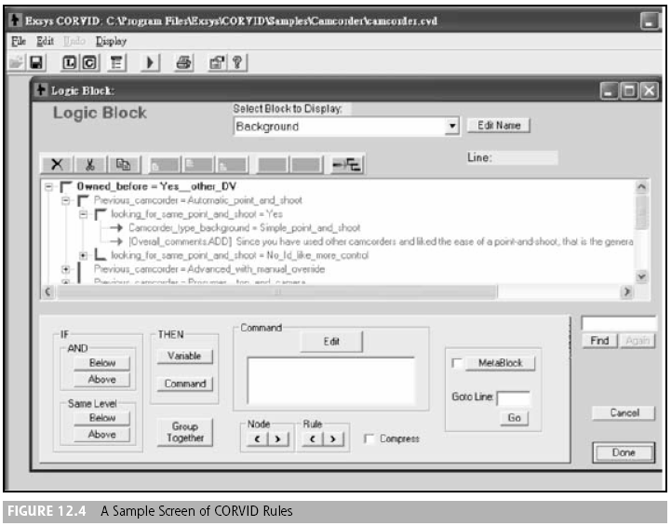
(12.9) Applications of ES

Slide 52
(12.9) Development of ES
There are three different kinds of development tools:
Tailored turn-key solutions
Contain specific features often required for developing applications in a particular domain

Slide 53
(12.9) Development of ES
The development of ES includes:
Choosing an ES development tool
Consider the cost benefits
Consider the technical functionality and flexibility of the tool
Consider the tool's compatibility with the existing information infrastructure
Consider the reliability of and support from the vendor

Slide 54
(12.9) Development of ES
The development of ES includes:
Coding the system
The major concern at this stage is whether the coding process is efficient and properly managed to avoid errors
Evaluating the system
Two kinds of evaluation:
Verification: no error in the code and achieves results the same as that acquired by the expert
Validation: solve the problem correctly

Slide 55
(12.9) Benefits, Limitations, and Success Factors of ES
Benefits of ES
Increased output and productivity
Decreased decision-making time
Increased process and product quality
Reduced downtime
Capture of scarce expertise
Flexibility
Easier equipment operation

Slide 56
(12.9) Benefits, Limitations, and Success Factors of ES
Benefits of ES
Elimination of the need for expensive equipment
Operation in hazardous environments
Accessibility to knowledge and help desks
Ability to work with incomplete or uncertain information
Provision of training

Slide 57
(12.9) Benefits, Limitations, and Success Factors of ES
Benefits of ES
Enhancement of problem solving and decision making
Improved decision-making processes
Improved decision quality
Ability to solve complex problems
Knowledge transfer to remote locations
Enhancement of other information systems

Slide 58
(12.9) Benefits, Limitations, and Success Factors of ES
Problems with ES
Knowledge is not always readily available
It can be difficult to extract expertise from humans
The approach of each expert to a situation assessment may be different yet correct
It is difficult to abstract good situational assessments when under time pressure
Users of ES have natural cognitive limits
ES work well only within a narrow domain of knowledge
Most experts have no independent means of checking whether their conclusions are reasonable

Slide 59
(12.9) Benefits, Limitations, and Success Factors of ES
Problems with ES
The vocabulary that experts use to express facts and relations is often limited and not understood by others
ES construction can be costly because of the expense of knowledge engineers
Lack of trust on the part of end users may be a barrier to ES use
Knowledge transfer is subject to a host of perceptual and judgmental biases
ES may not be able to arrive at conclusions in some cases
ES sometimes produce incorrect recommendations

Slide 60
(12.9) Benefits, Limitations, and Success Factors of ES
Factors in disuse of ES
Lack of system acceptance by users
Inability to retain developers
Problems in transitioning from development to maintenance
Shifts in organizational priorities

Slide 61
(12.9) Benefits, Limitations, and Success Factors of ES
ES success factors
Level of managerial and user involvement
Sufficiently high level of knowledge
Expertise available from at least one cooperative expert
The problem to be solved must be mostly qualitative
The problem must be sufficiently narrow in scope

Slide 62
(12.9) Benefits, Limitations, and Success Factors of ES
ES success factors
The ES shell must be of high quality and naturally store and manipulate the knowledge
The user interface must be friendly for novice users
The problem must be important and difficult enough to warrant development of an ES
Knowledgeable system developers with good people skills are needed

Slide 63
(12.9) Benefits, Limitations, and Success Factors of ES
ES success factors
End-user attitudes and expectations must be considered
Management support must be cultivated
End-user training programs are necessary
The organizational environment should favor adoption of new technology
The application must be well defined, structured, and it should be justified by strategic impact

Slide 64
ES on the Web
The relationship between ES and the Internet and intranets can be divided into two categories:
The Web supports ES (and other AI) applications
The support ES (and other AI methods) give to the Web

Slide 65
Dendral
Procedure:
(a) Spectra data given as input
(b) Preliminary analysis determines
- Necessary compounds -- spectra data
- Forbidden compounds -- spectra data, expert knowledge
(c) Generate and test:
a) Structure enumerator : can generate all possible compounds
- Takes necessary and forbidden lists, and creates a new possible Compound
- Output is formula
b) Spectra synthesizer : generates spectra data for this compound
c) Matcher - matches synthesized spectra with actual one
- compound with best fit is the one
Working: The spectrogram machine bombard a sample with high energy electrons, causing the molecule to break up into charged chunks of various sizes.
Then, the machine sorts the chunks by passing them through a magnetic field which deflects the high-charge, low-weight ones more than it does the low-charge, high charges ones.

Slide 66
MYCIN
MYCIN has following features:
(1) Stanford University in mid 70's.
(2) Domain: Medical diagnosis for bacterial and meningitis infections.
(3) Task: interview physician, make diagnosis and therapy recommendations
(4) Input: Answers to queries.
(5) Output: Ordered set of diagnoses and therapies.
(6) Architecture: rule-based exhaustive backward chaining with uncertainty.
(7) Tools: programmed in LISP (shell called EMYCIN -- empty MYCIN).
(8) Results: not in general use, but was ground-breaking work in diagnostic consultation system
a) Mycin is an Expte system for diagnosing and recommending treatment of bacterial infection of blood.
(b) It was developed in Stanford University in California.
(c) A consolation with MYCIN begins with request for routine information such as age, medical history, and so on, progressive to more specific questions as required.
(d) MYCIN represented its knowledge as a set of if……….THEN rules with certainty factors.

Slide 67
Mycin
Working MYCIN’s expertise knowledge lies in the domain of bacterial infections. MYCIN’s pools of knowledge consist of approximately 500 antecedent- consequently rules which give MYCIN the ability to recognize about 100 causes of bacterial infections. MYCIN helps the physician to prescribe disease- specific drugs. MYCIN informs itself about particular cases by requesting information from the physician about patient’s symptoms. At each point the question MYCIN asks is determined by MYCIN’s current hypothesis & the answer to all previous question at the end, it provides

Slide 68
REFERENCES
Artificial Intelligence: A Modern Approach by Stuart Russell and Peter Norvig. Prentice-Hall, 2003 (2nd Edition).

Slide 69
THANK YOU

